Slide 1
Chapter topics:
Advance treatment: Crystal Field Theory (CFT)
Ligand Field Theory (LFT) for octahedral and tetrahedral complexes
Tetragonally distorted octahedral complex and square planar complexes
Molecular orbital Theory (MOT)
Metal-ligand σ- and π- bonding
CFSE
Consequences of ligand field splitting>>>> Magnetic properties, electronic properties
Electrochemical series
Structural and thermodynamic effects of ligand field splitting
Jahn-Teller theorem/effect

Slide 2
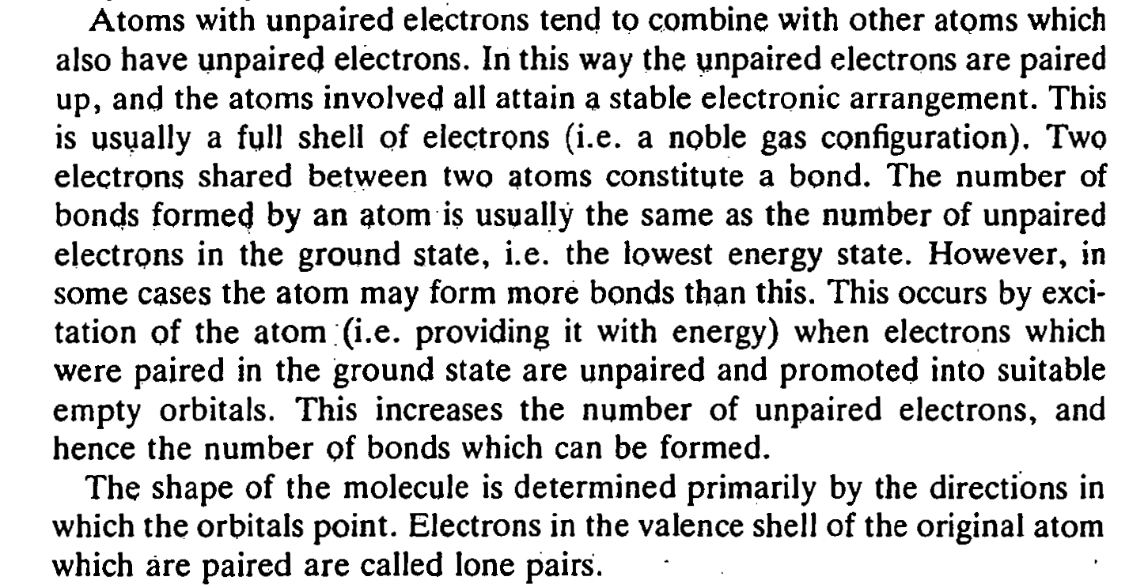
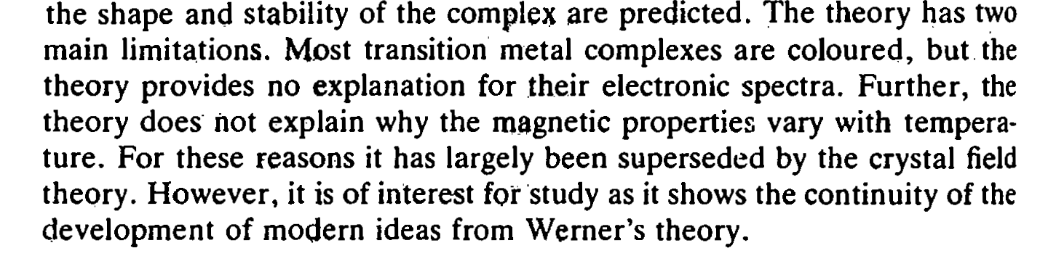
Implications of VBT:
*Hybridization
*EAN
*18 electron rule
1916
Linus Pauling published in 1931 his landmark paper on valence bond theory
Limitations of VBT led to CFT

Slide 3
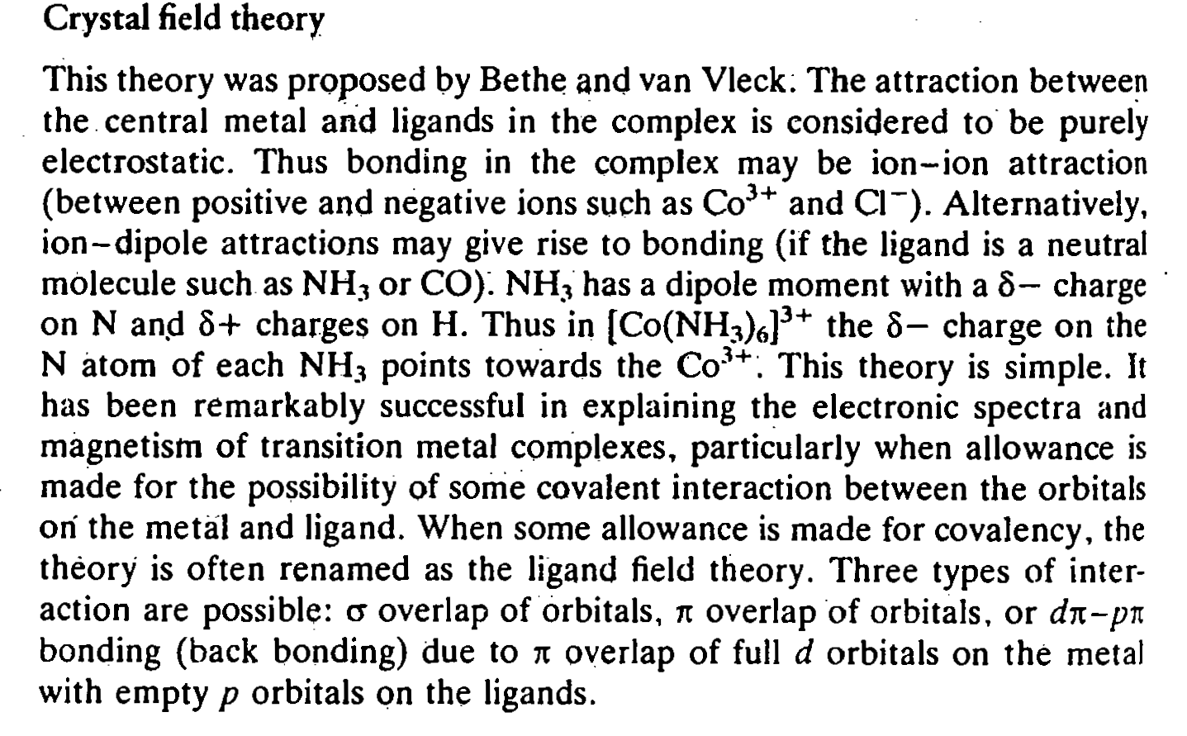
The crystal field theory (CFT) was developed for crystalline solids by the physicist Hans Bethe in 1929.

Slide 4
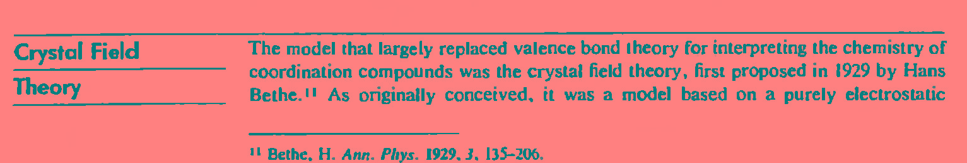
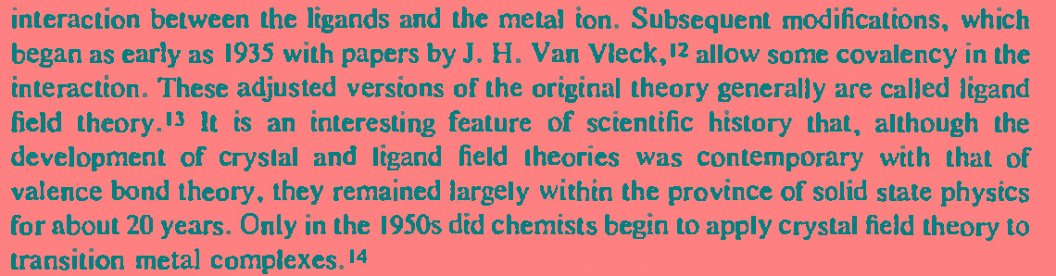
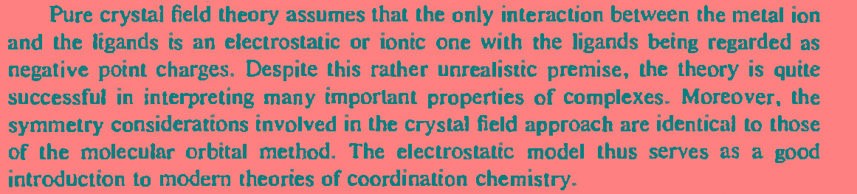

Slide 5
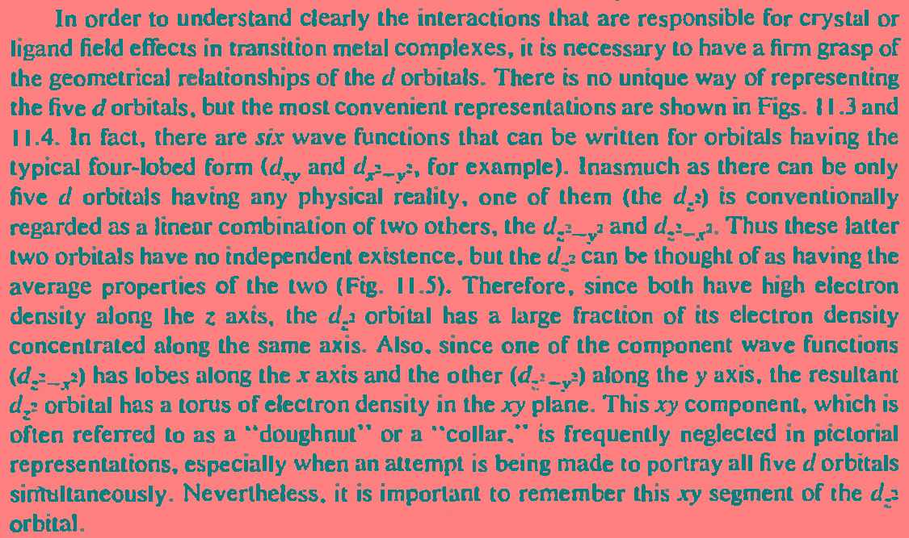

Slide 6
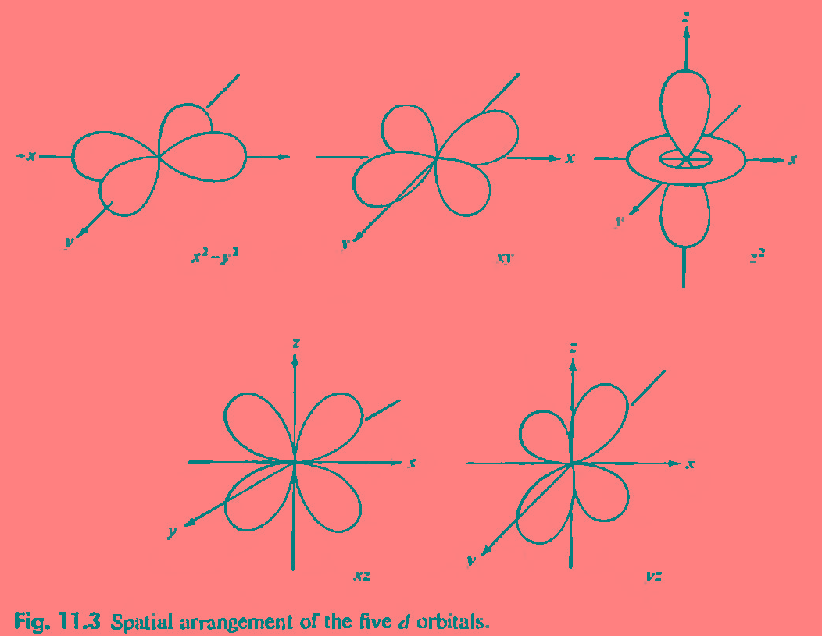
Combination of d_{z}²_{-x}² and d _{z}²_{-y}²

Slide 7
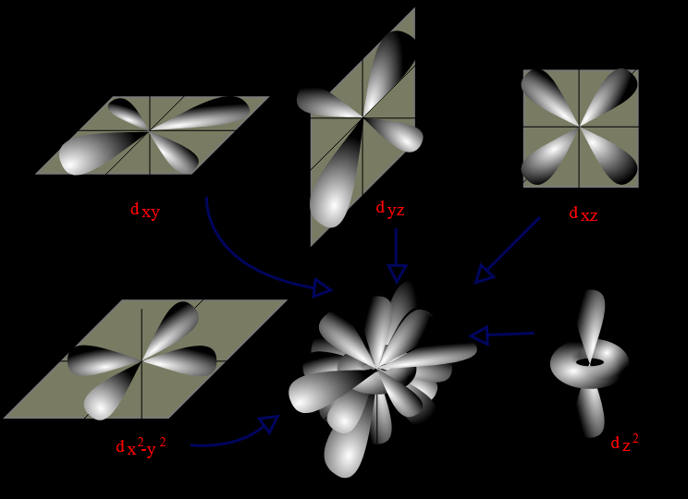

Slide 8
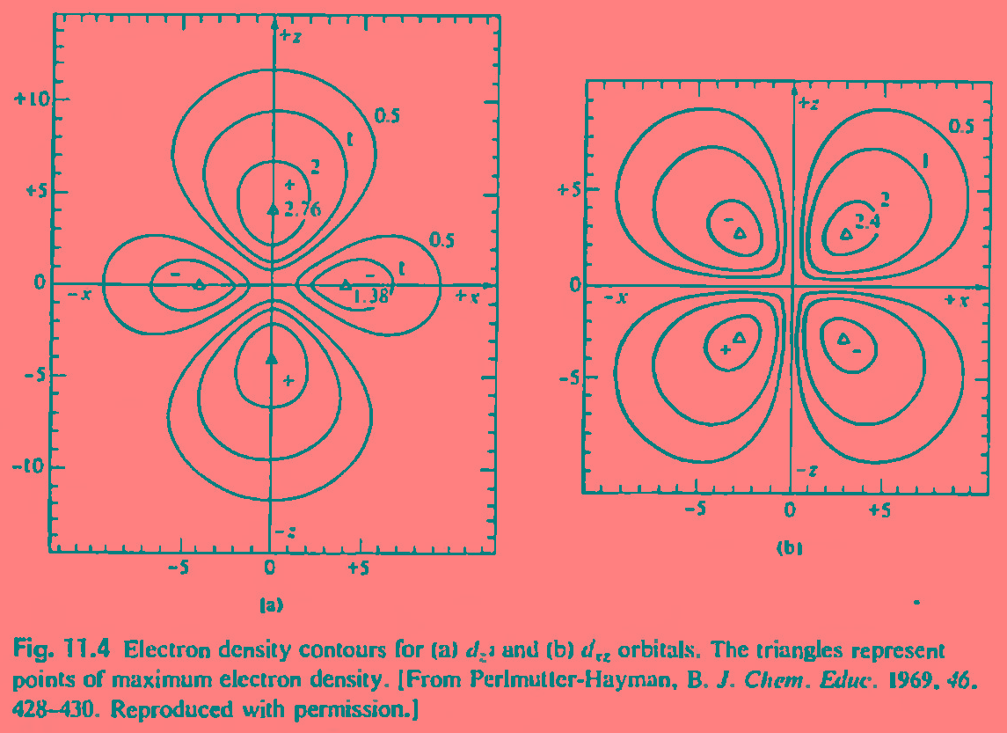

Slide 9
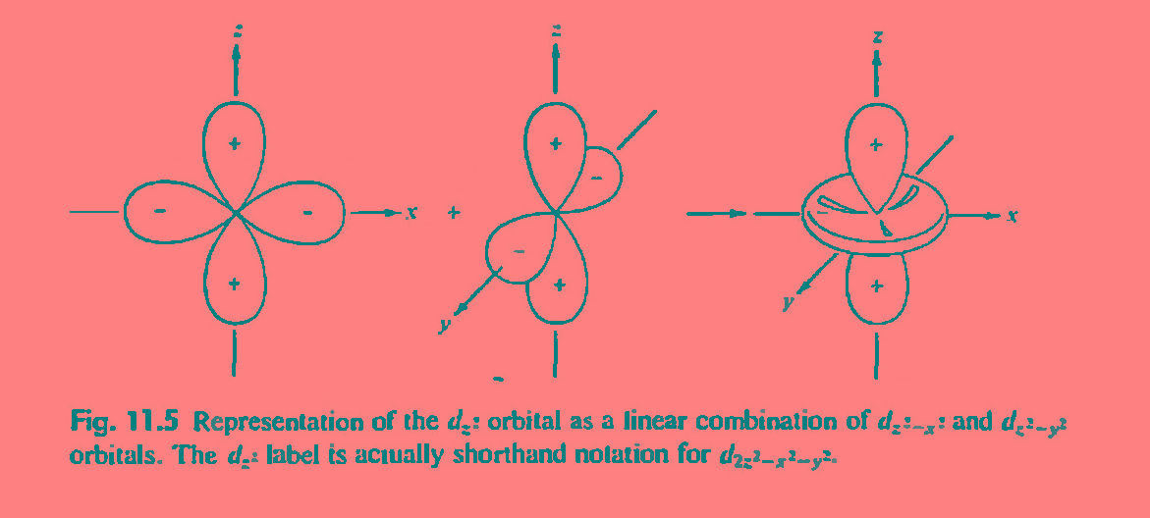
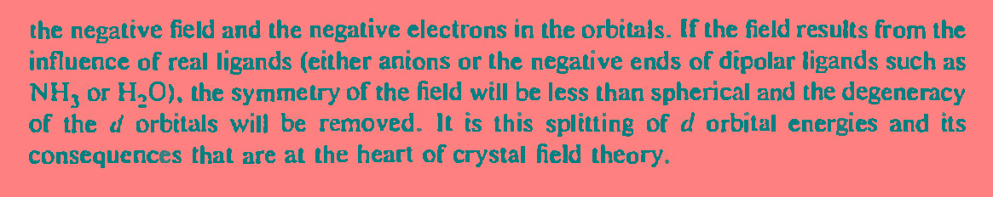
Doughnut
or collar

Slide 10
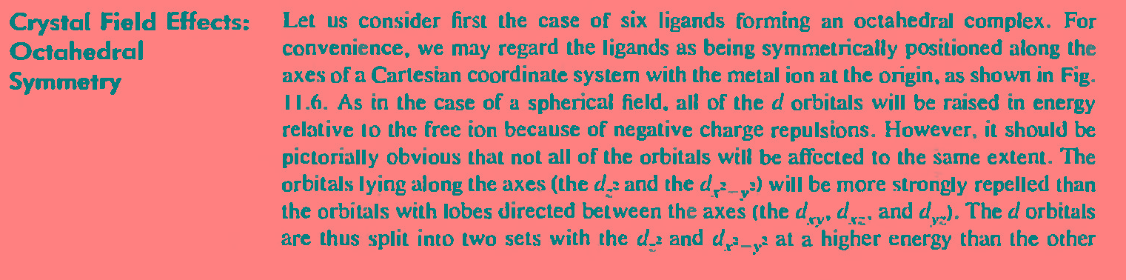
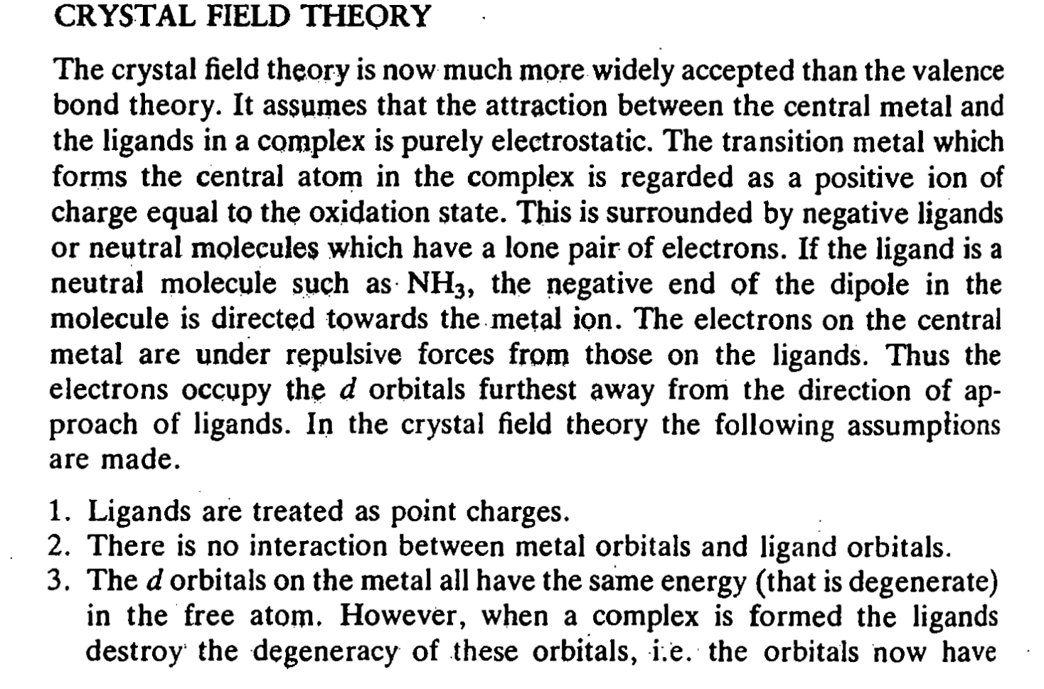

Slide 11
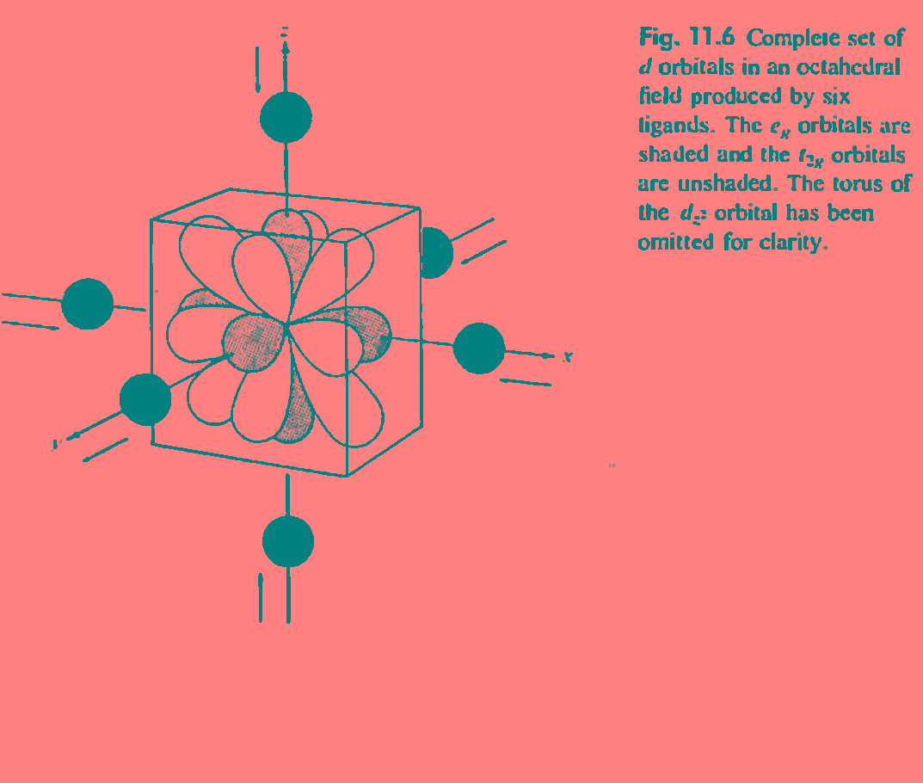
L
shade
L
L
L
L
Un-shaded
L

Slide 12
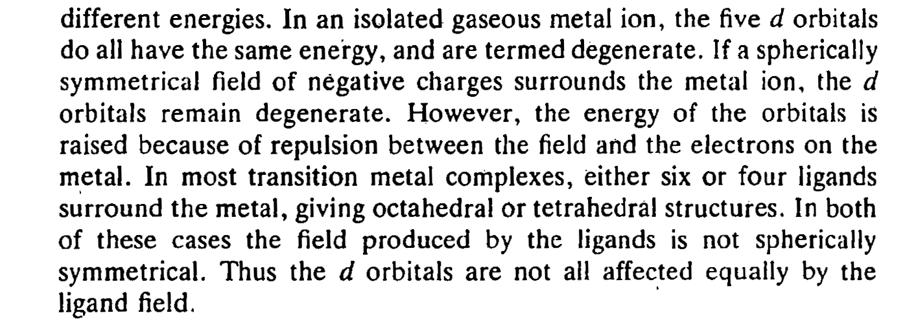

Slide 13
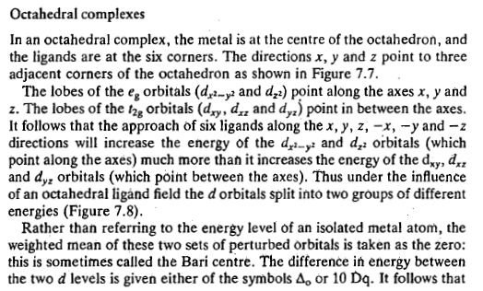

Slide 14
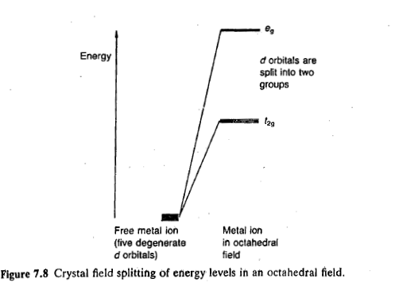

Slide 15
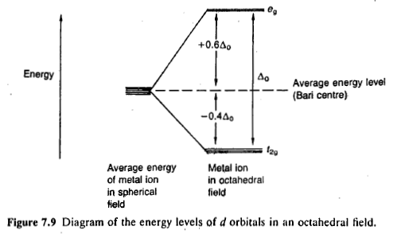

Slide 16
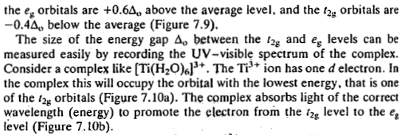

Slide 17
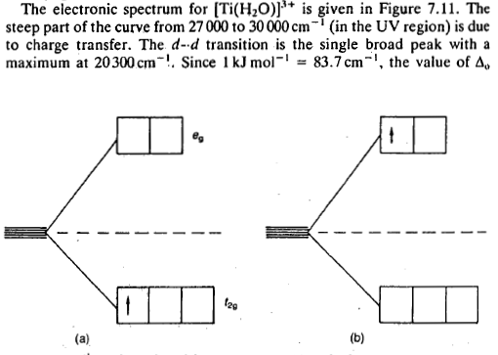
Example of d-d transition

Slide 18
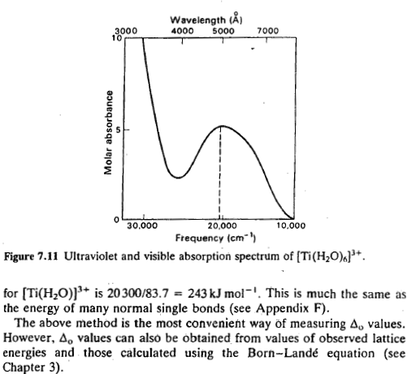

Slide 19
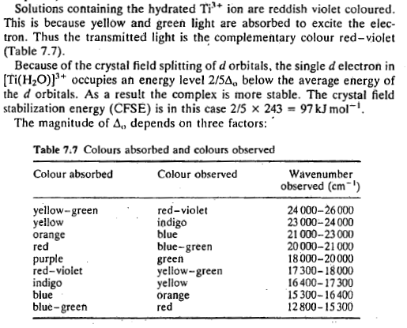
Color complementarity in T. metal aqueous solutions

Slide 20
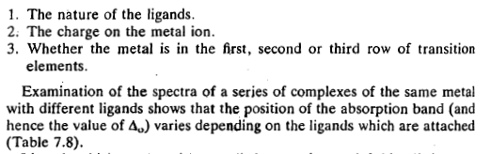
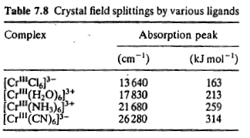

Slide 21
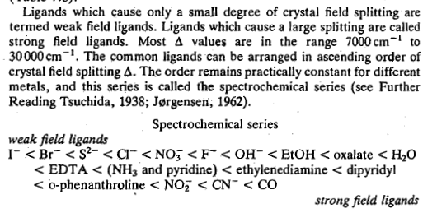
Weak Field/ Strong field ligand>>>> Spectrochemical series

Slide 22
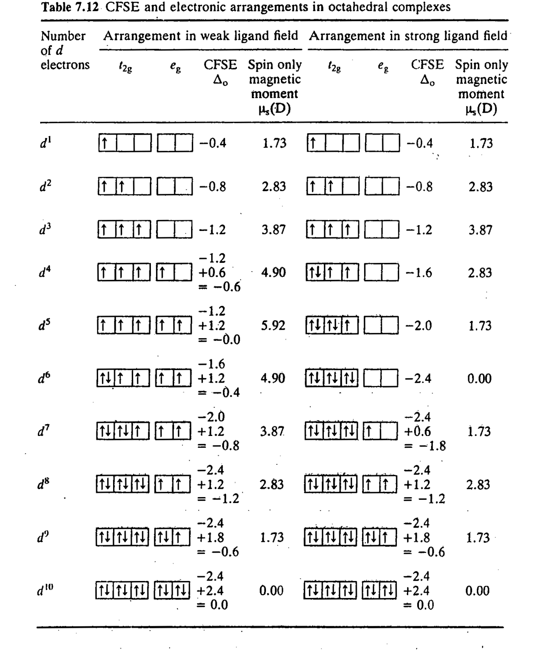
Mag mom start to change from here
For strong and weak field ligands ,
Mag mom differs significantly

Slide 23
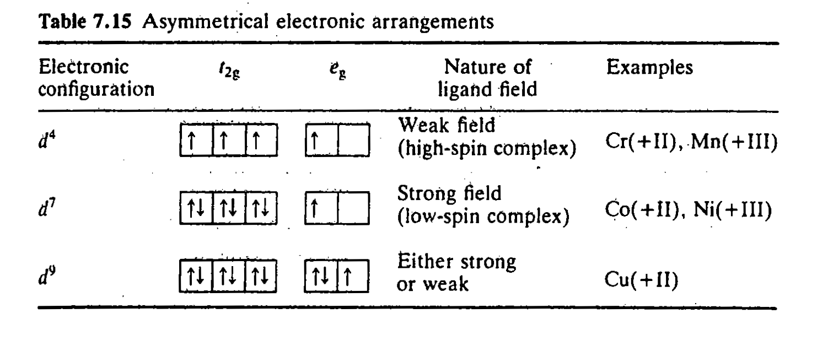
The eg orbitals point directly at . the ligands. Thus asymmetric filling of the eg orbitals results in some ligands being repelled more than others. This causes a -significant distortion of the octahedral shape. In contrast the t2gorbitals do point directly at the ligands, but
point in between the ligand directions. Thus asymmetric filling of the t2g orbitals has only a very small effect the stereochemistry. Distortion caused by asymmetric filling of the t2g orbitals is usually too small to measure. The electronic arrangements which will produce a large distortion are shown in Table 7.15.

Slide 24
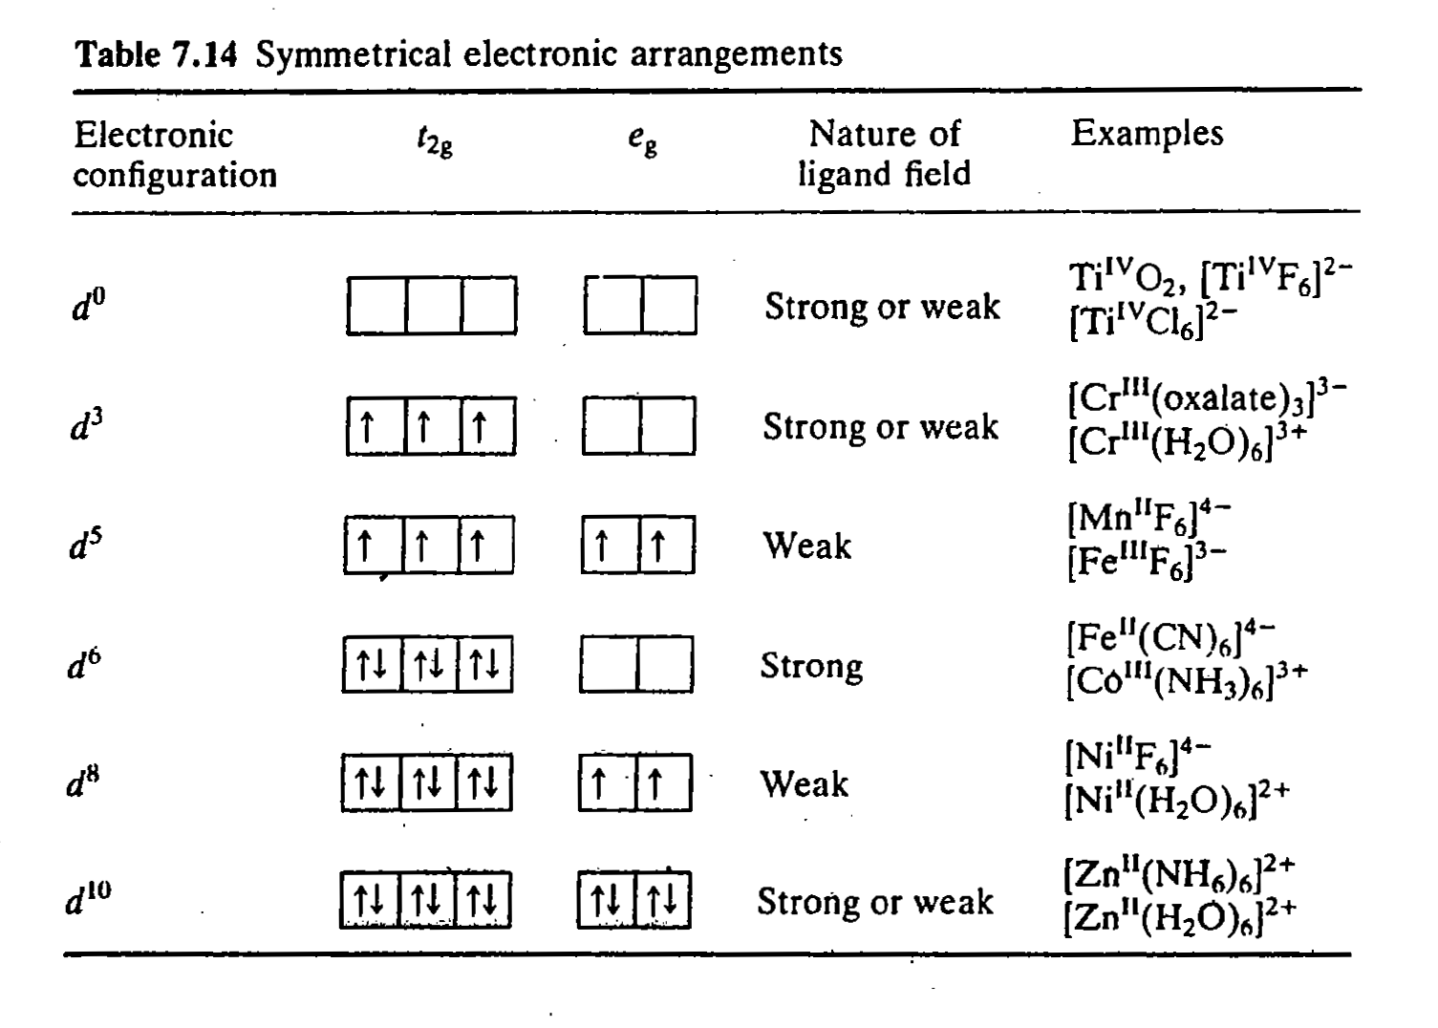

Slide 25
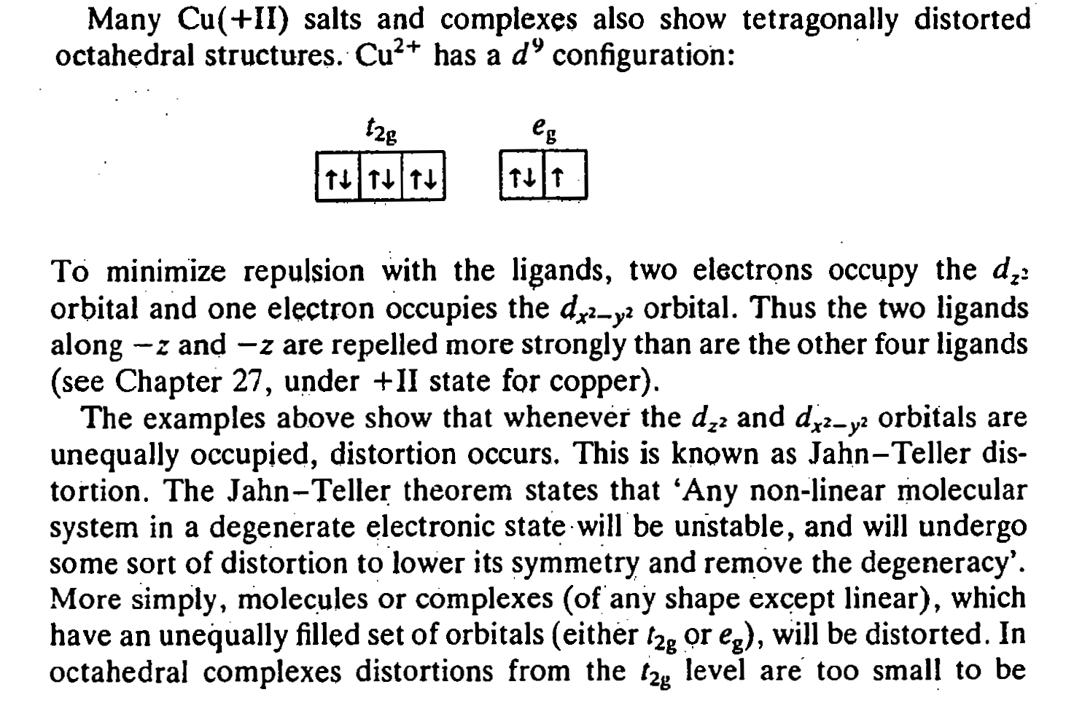

Slide 26
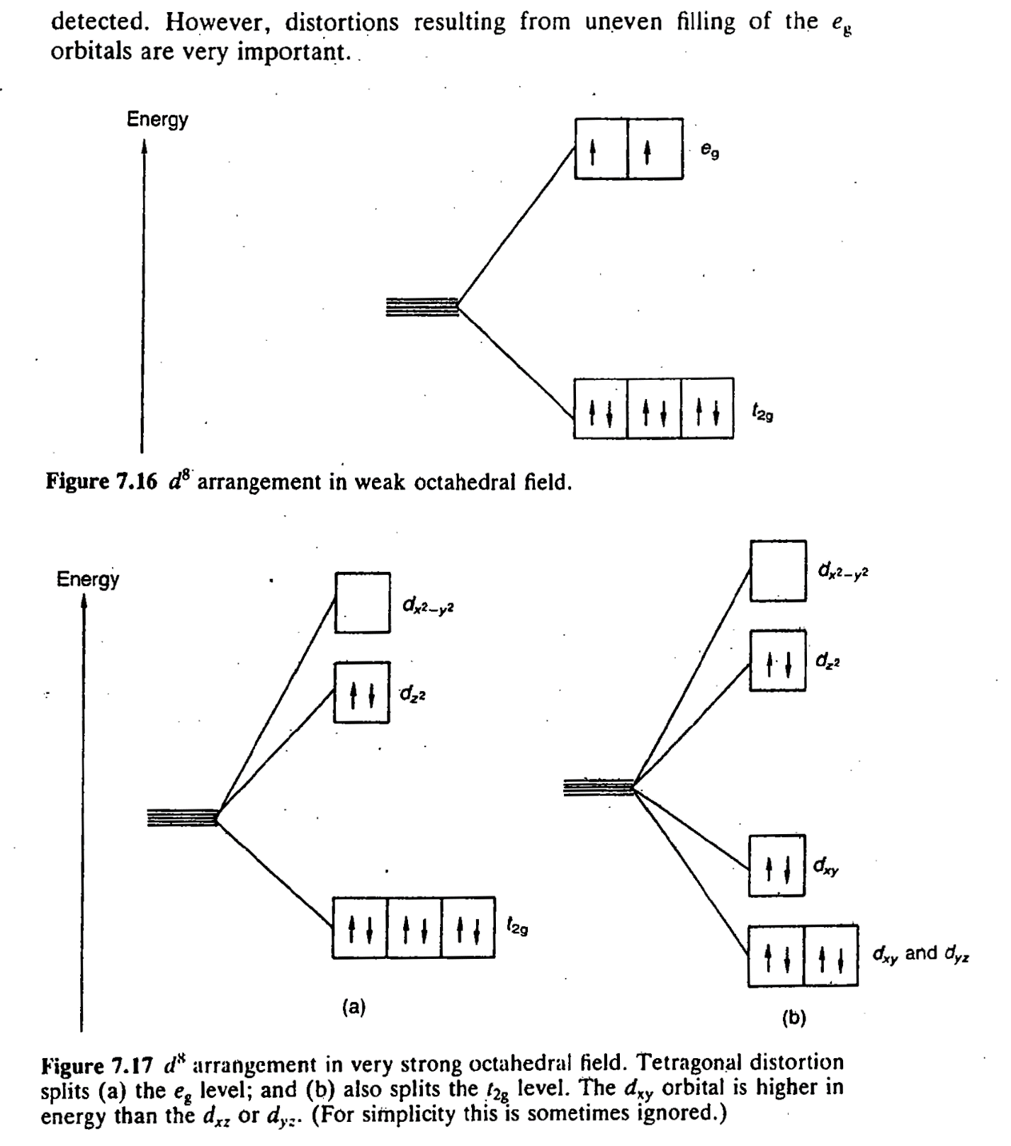
Due to strong ligand electron repulsion
eg orbital degeneracy breaks

Slide 27
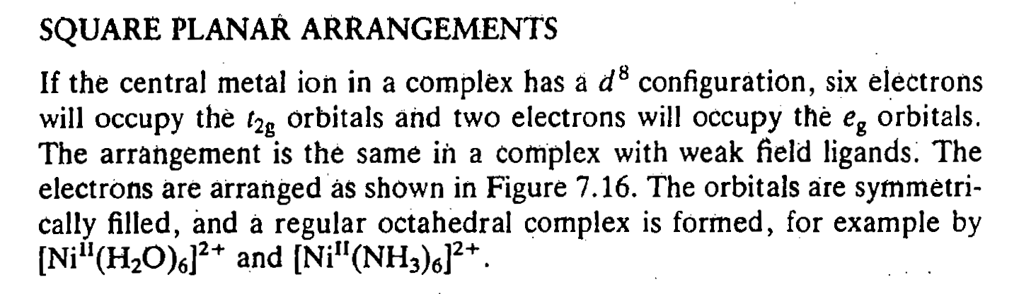
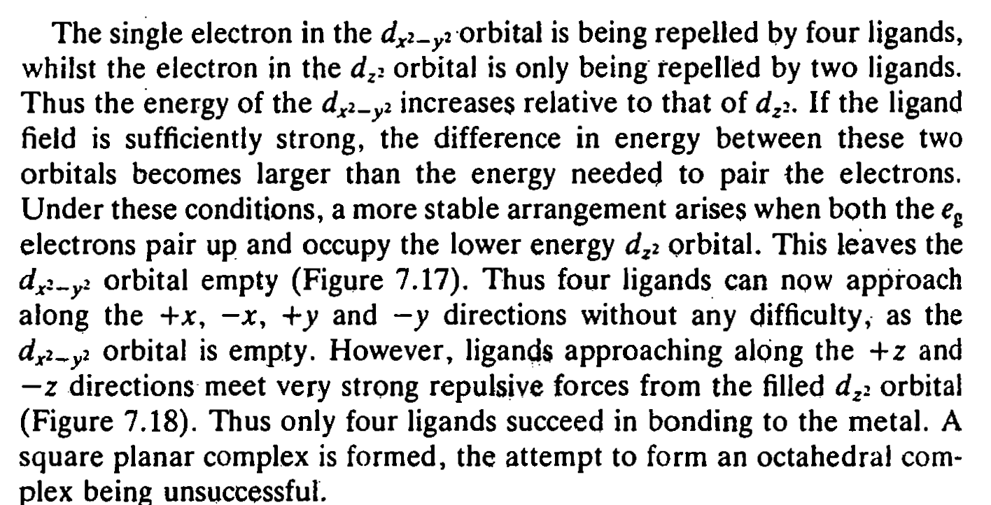

Slide 28
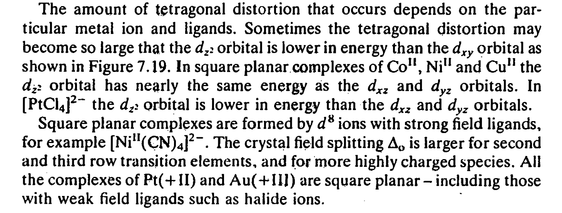

Slide 29
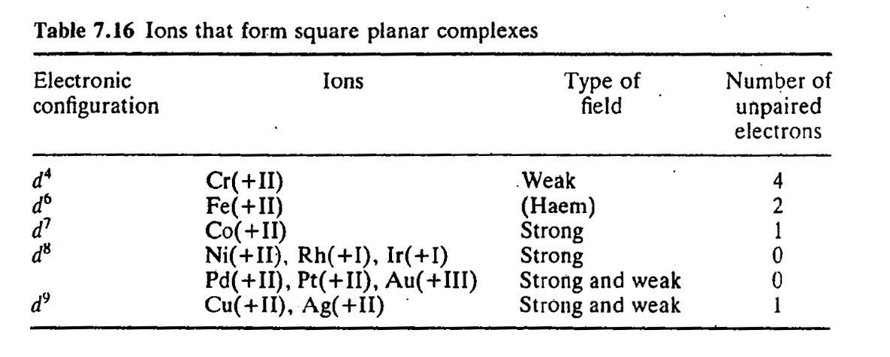
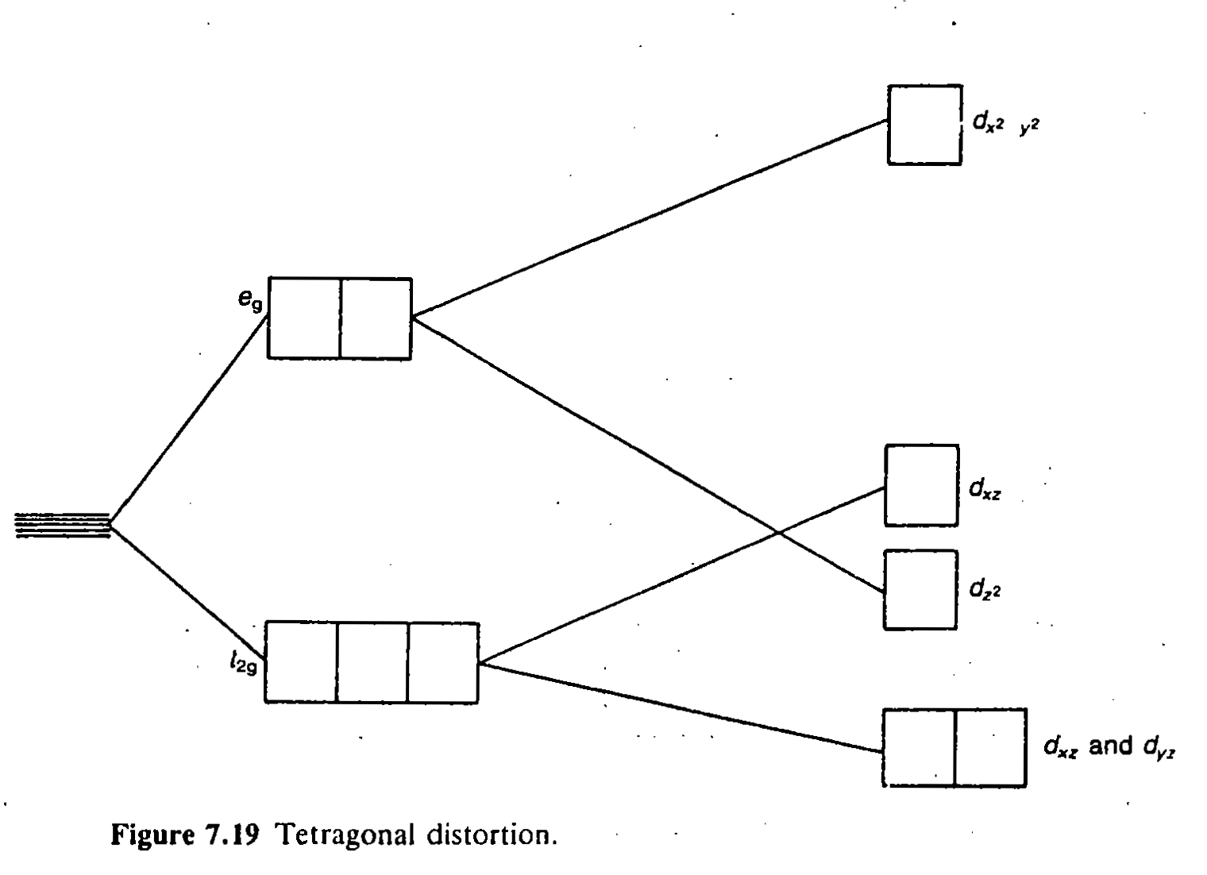

Slide 30
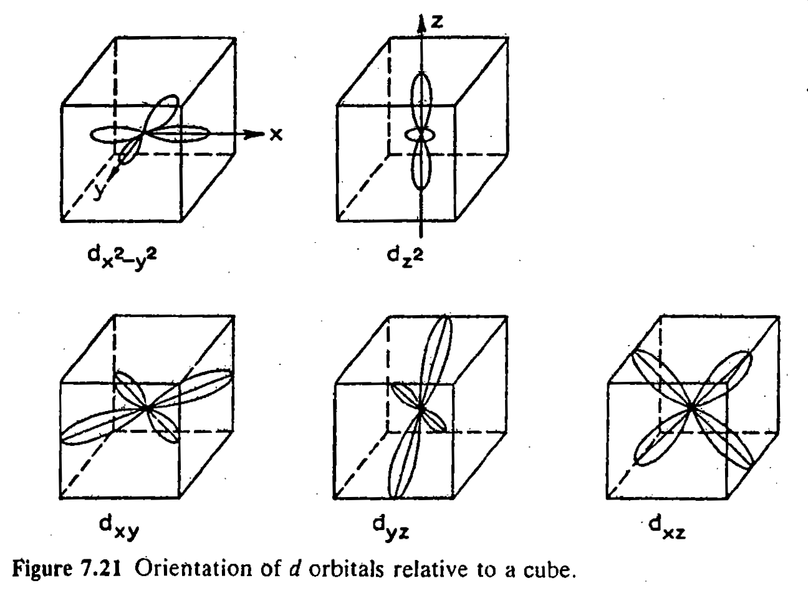
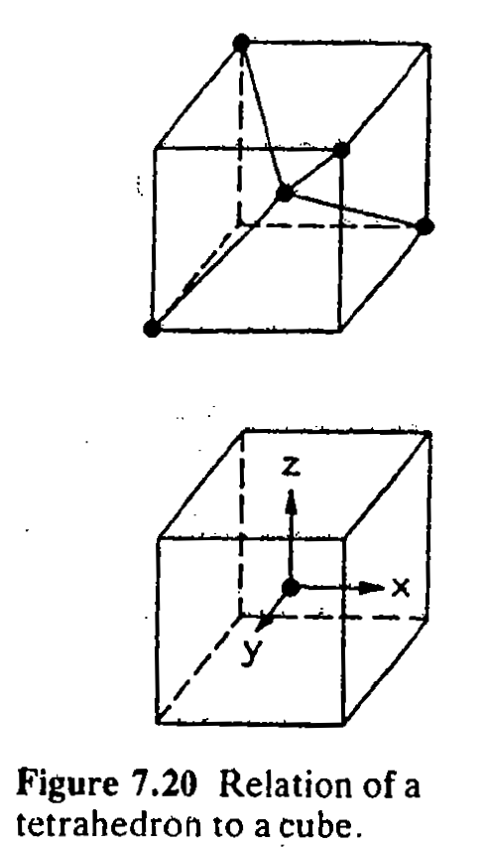

Slide 31
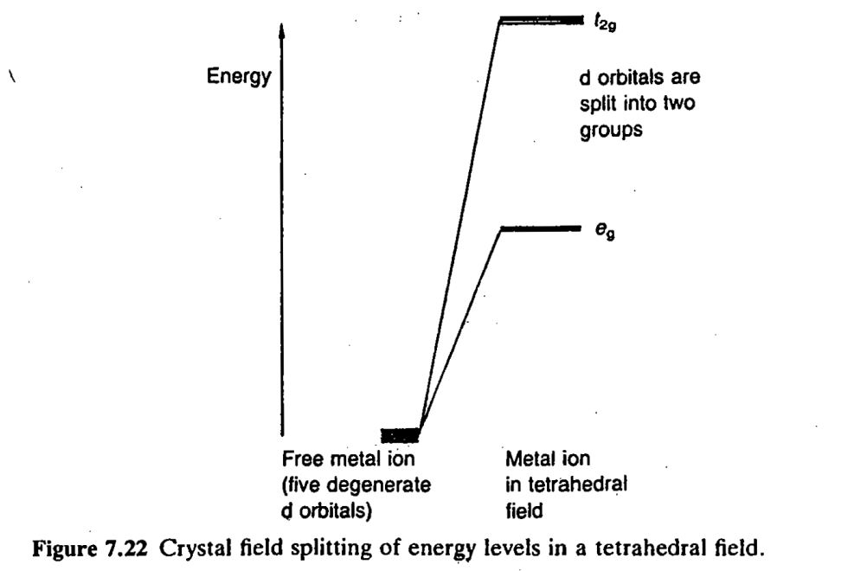
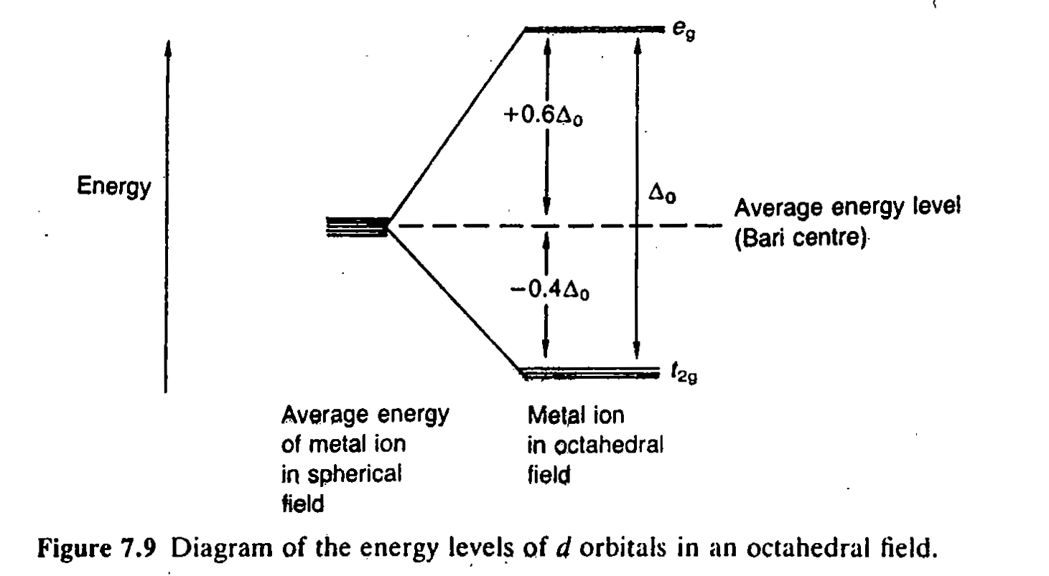

Slide 32
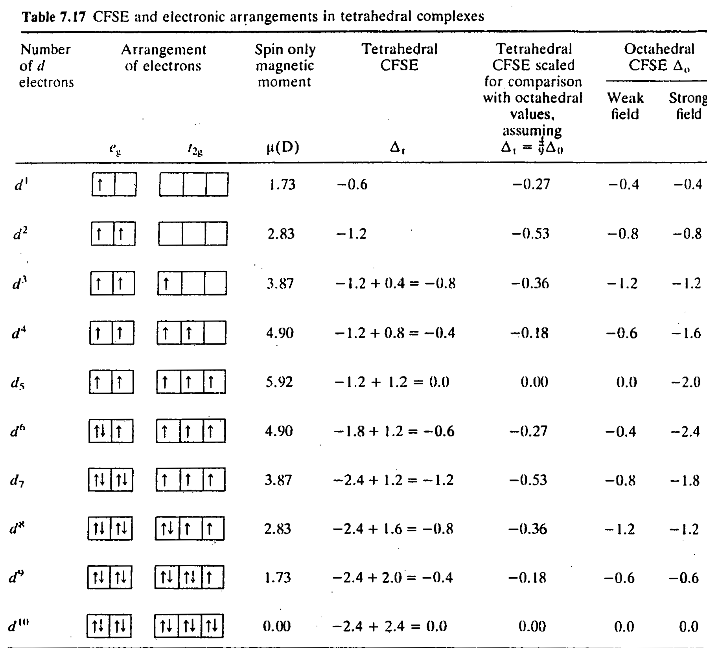

Slide 34
6 coordinate complex

Slide 35
4 coordinate complex

Slide 39
